Slide 1

American Indian Higher Education Consortium
AIHEC:
Spring BoD Meeting
2011
April 13, 2011
The collective spirit and unifying voice of our nation’s Tribal Colleges and Universities.
Notes:
Discussion Points
Background: Tribal College Movement
TCUs Today: Growth & Programs
Challenges: Accountability
Future: Sustainable TCUs & Communities

Slide 2
:
FY 2011 Appropriations
7th Continuing Resolution,
expires 4-14-2011
Pub L. 112-10 - Final CR funding remainder of FY 2011 signed 4-15-2011
The collective spirit and unifying voice of our nation’s Tribal Colleges and Universities.

Slide 3
Key Points of Final CR
Key TCU Programs:
RESTORED Sec. 117 Perkins
(Tribal Career and Technical
PELL MAXIMUM MAINTAINED ($5,550), BUT NO “Year-Round” PELL
ELIMINATES HUD-TCUP and all MSI PROGRAMS
MAINTAINS USDA-TCU COMMUNITY FACILITIES PROGRAM
TCU Title III = Level
1994 Land-grant Programs Level w/2010
Across-the-Board Rescission of 0.2 percent for ALL Discretionary Accounts.
All MANDATORY funding maintained.

Slide 4
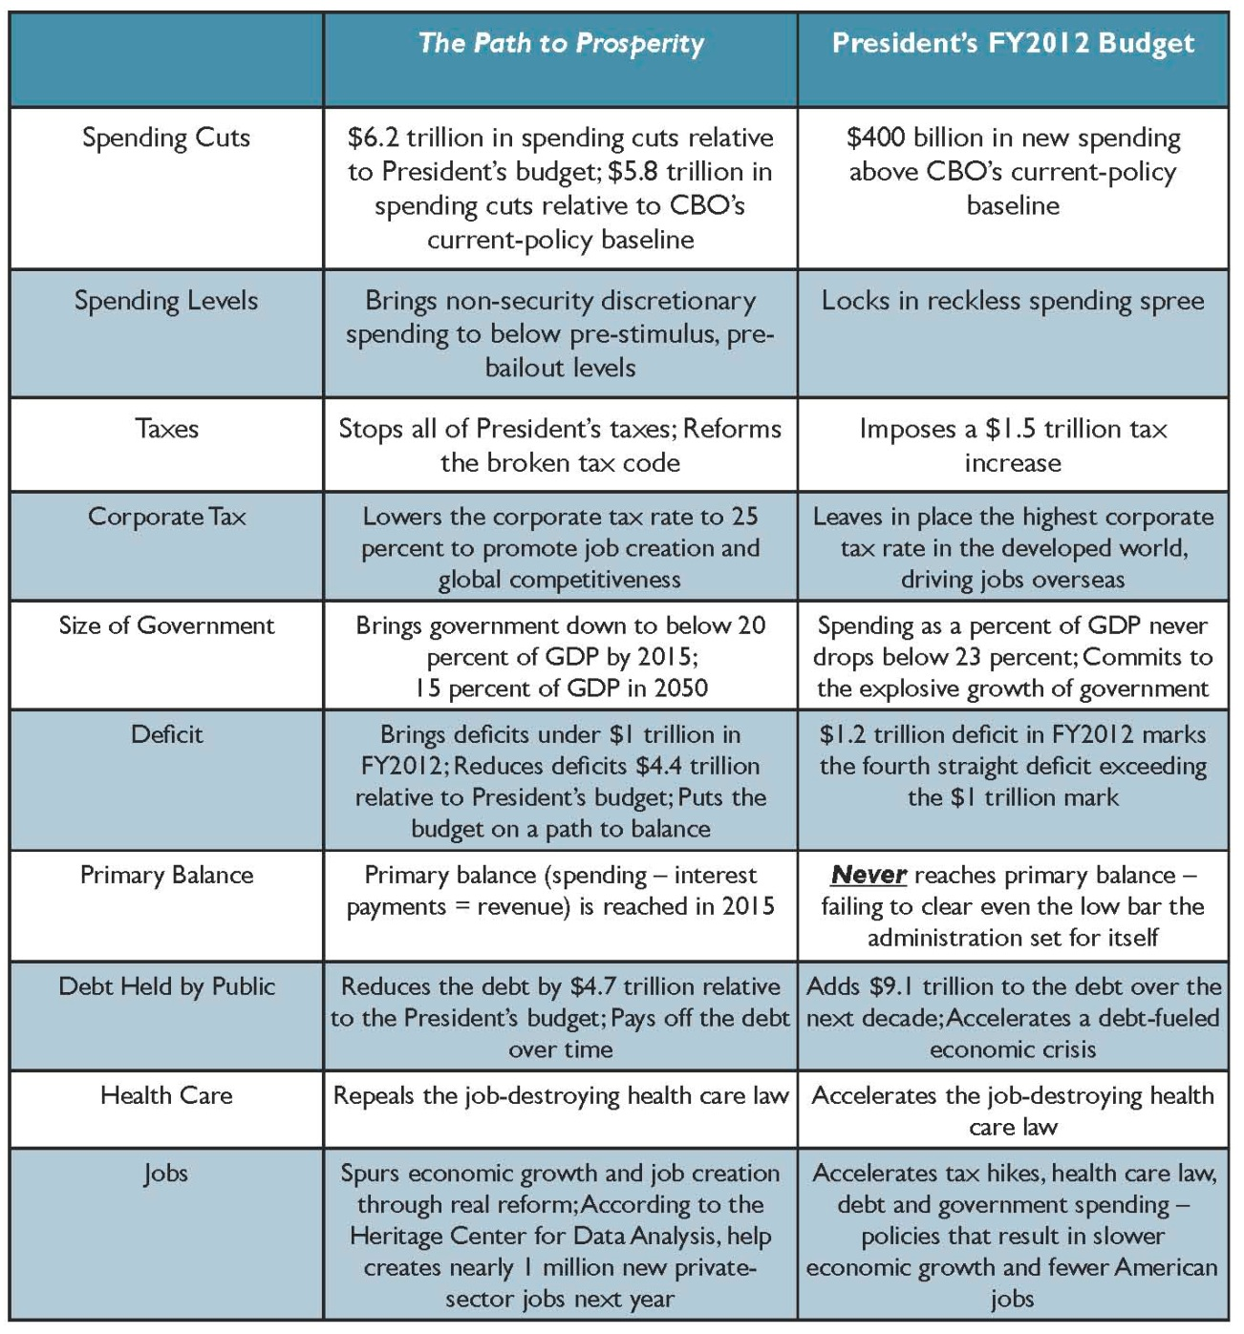
:
FY 2012 Appropriations: The Rhetoric
The collective spirit and unifying voice of our nation’s Tribal Colleges and Universities.
House Budget Committee
April 5, 2011

Slide 5
Other Budget Issues
FY 2012 Appropriations: Behind Schedule
Debt Ceiling: May 2011
Long-term Deficit Reduction
The collective spirit and unifying voice of our nation’s Tribal Colleges and Universities.
AIHEC Proprietary

Slide 6
Other Issues To Discuss
Legislative Update:
  Reauthorizations & Initiatives
ED Regulatory Changes
Potential Health Promotion
Vision Statement for Indian Ed
TCU Executive Order
The collective spirit and unifying voice of our nation’s Tribal Colleges and Universities.
AIHEC Proprietary

Slide 7
Legislative Update:
Reauthorizations & Initiatives
ESEA: Teacher Training for AI Teacher Corp
      Making TCUs the primary recipient
WIA: Adult Basic Education
      Annual set-aside for TCUs from funds appropriated for State administered grants
Farm Bill: Initial phase of 2012 Reauthorization
THE PATH: Introduction in House and Senate
      Possible Addition of AI Social Worker training component
      Need to find offsets for overall cost of the bill

Slide 8
ED Regulatory Changes
2008 HEA reauthorization included a raft of new regulations. Some of the more contentious are that are scheduled to be implemented July 1, 2011, include:
    Universal definition of credit hours
    Out of state distance education programs
    Peer-to peer file sharing (copy rights infringement)

Slide 9
Potential Health Promotion &
Vision Statement for Indian Ed
Potential Cooperative Agreement with CDC: AIHEC has been asked to apply for a cooperative agreement with the CDC. Seeks Boards’ approval to pursue.
Vision Statement for Indian Education: Working with NIEA and NCAI to craft a vision statement for the future of Indian Education – for promotion during the 2012 Presidential Election cycle

Slide 10
TCU Executive Order
The Department of Education continues to promote the notion of a cradle to career Indian Education EO, which includes “other institutions of higher education” as supported by other Indian organizations (NIEA, NCAI?)
Toolkit: includes letters and recommended action for each TCU (president, board members, faculty, and students) to take to advance a separate EO on TCUs.

Slide 11
AIHEC Contact Information
Carrie L. Billy
President & CEO
AIHEC
121 Oronoco Street
Alexandria, VA 22314
703.838.0400 x110
cbilly@aihec.org
www.aihec.org
The collective spirit and unifying voice of our nation’s Tribal Colleges and Universities.

